Slide 1
Understanding Conformance Testing Using the NIST HL7 v2 LOI Validation Tool
Conformance Criterion:
Transmit laboratory orders
Robert Snelick, NIST (rsnelick@nist.gov)
January 31, 2017

Slide 2
Purpose
Provide an additional resource to explain the process of HIT Module conformance testing related to HL7 v2 Laboratory Order Interface (LOI) Messaging
Describe NIST approach for assessing and validating the test messages
Provide an overview of the testing requirements

Slide 3
Table of Contents
List of Resources
Scope of Conformance Testing
Transmit laboratory orders criterion and conformance standards
Testing Process Diagram
Testing Workflow Diagrams
Explanation of Test Scenarios and Test Cases/Steps
Example Test Step Documents
Explanation of Test Data Categorization and Validation
Test Tool Overview and Example Test Tool Screen
Additional Resources

Slide 4
Resources
Test Tool Web Site (hl7v2-loi-r1-testing.nist.gov)
Validation Tools
User Documentation
Normative Test Process Document (on Test Tool Documentation Tab)
S&I Framework Lab Order Interface (LOI) Implementation Guide
(http://www.hl7.org/implement/standards/product_brief.cfm?product_id=152 )
LOI-EHR Tool Quick Reference Guide (In Process)
LOI-EHR Tool Tutorial (In Process)
Release Notes for each version of Test Tool
(on Test Tool Documentation Tab)
LOI Test Tool Google Group for submitting questions to the Test Tool developers
(https://groups.google.com/d/forum/hl7v2-lab-orders-interface-testing )

Slide 5
Scope of Conformance Testing - LOI-EHR
Testing is directed at a Health IT Module (product), not specific instances (installations) of the Module
The conformance criterion is focused on testing the capability of an HIT Module to create HL7 messages for transmission of orders for clinical laboratory tests
Site-specific configuration of the HIT Module is not being tested
Method of transmitting the order messages is not being tested
Testing focus and scope are narrow
Testing encompasses only specific use cases described in the LOI Implementation Guide (IG)
Testing does not attempt to address the entire spectrum of use cases found in practice
How the LOI messages are transmitted/exported from the HIT Module is out of scope
Receiving HIT Modules (e.g., LISs) are not being tested using the LOI-EHR Test Plan in the LOI Test Tool
HIT Module conformance testing is driven by the test data
The HIT Module is required to demonstrate the ability to create HL7 v2 lab order messages; specific test data for the messages are provided in Test Cases
The test data and Test Cases do not cover all possible clinical lab tests; through consultation with clinical laboratory experts, a subset of key lab tests were selected for testing
The format in which the test data are displayed on the screen of the HIT Module is not part of the testing
Clinical laboratory subject matter experts, in collaboration with the National Institute of Standards and Technology (NIST), provided the Test Scenarios, Test Cases, and Test Data for the Laboratory Order Interface (LOI) conformance testing

Slide 6
Conformance Criterion - LOI-EHR
Create laboratory orders testing evaluates the capability for an HIT Module in the ambulatory setting to generate laboratory orders for electronic transmission via messages that are conformant to
HL7 Version 2.5.1 Implementation Guide: S&I Framework Laboratory Orders from EHR, Release 1, DSTU Release 2 - US Realm (November 2015)
Logical Observation Identifiers Names and Codes (LOINC) version 2.50 vocabulary standard

Slide 7
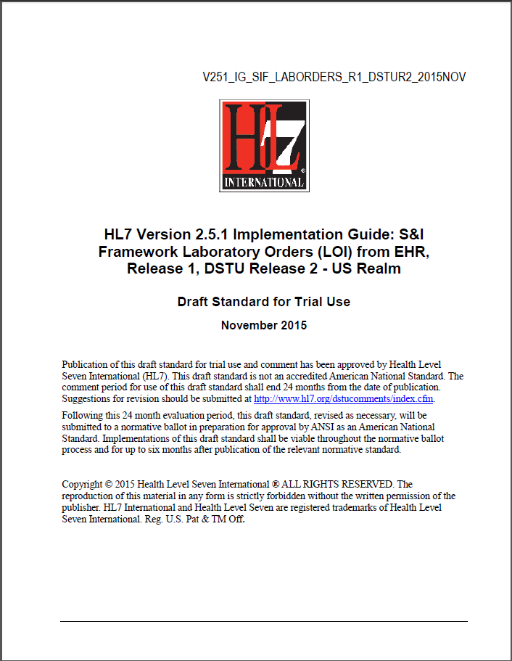
Conformance Standards Document – LOI-EHR
HL7 v2.5.1 LOI Implementation Guide, Release 1, DSTU Release 2, Nov 2015
http://www.hl7.org/implement/standards/product_brief.cfm?product_id=152

Slide 8

Vocabulary Standard Web Site – LOI-EHR
LOINC® Database version 2.50
http://loinc.org/

Slide 9
Create Laboratory Orders Testing Process
HL7 LOI IG 2015
HIT Module
(System under Test)
Conformance Test Scope
LIS or EHR-S Lab Module
Message
Exported*
OML Elements
Direct Data Entry
OML Message
Message
Imported*
NIST Test Tool (Validation Tool)
OML Message Elements
Diagram does not show testing process for Acknowledgment messages or messages for cancellation of an order sent via the LIS
The HIT Module (e.g., EHR-S) is the system being tested. The HIT Module is required to create messages that meet the conformance and vocabulary standards (See previous slides).
Test data can be entered into the Module directly via the user interface (manually) or can be imported via an incoming message (using any automated method).
The Module is expected to process the test data to create a message. This message is exported* from the Module and imported* into the NIST Test Tool for automated validation.
Test data are available through the Test Tool via the Test Steps. Each Test Step includes a Test Story that provides the context, a Test Data Specification that lists the test data, a Message Content Data Sheet that shows a conformant message (in a table format) including a detailed profile of the required elements, a Test Message, and (where applicable) a Juror Document.
*How the message is exported/imported/received is not in-scope for certification testing

Slide 10
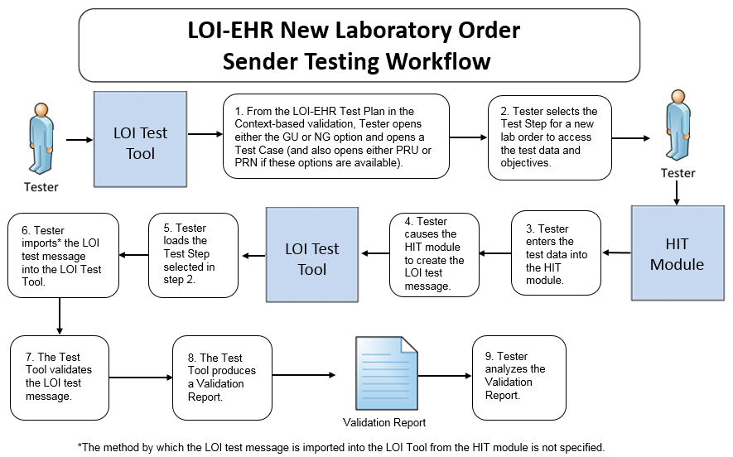
Create New Lab Orders Testing Workflow Diagram
This diagram shows
How the steps of the create new lab orders test are sequenced
When the Test Tool is to be used
Testing workflow diagrams for Cancel Order messages and Add-on Test messages are available in the NIST LOI-EHR Normative Test Process Document accessed via the Documentation tab in the LOI Tool

Slide 11
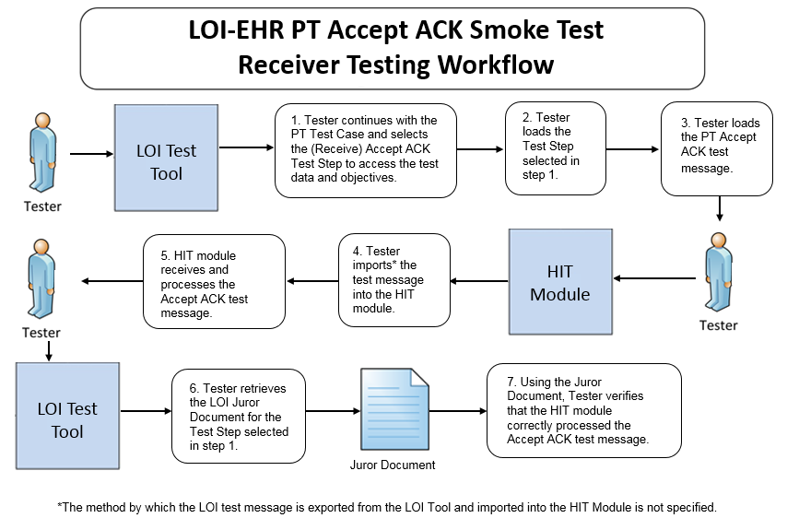
Receive Accept ACK Testing Workflow Diagram
This diagram shows
How the steps of the receive Accept Acknowledgement* test are sequenced
When the Test Tool is to be used
*Acknowledgement messages are tested only in the PT Test Scenario

Slide 12
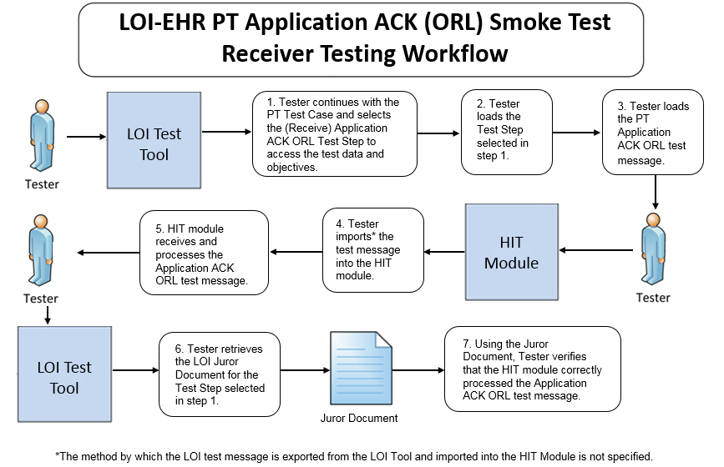
Receive Application ACK Testing Workflow Diagram
This diagram shows
How the steps of the send Application Acknowledgement* test are sequenced
When the Test Tool is to be used
*Acknowledgement messages are tested only in the PT Test Scenario

Slide 13
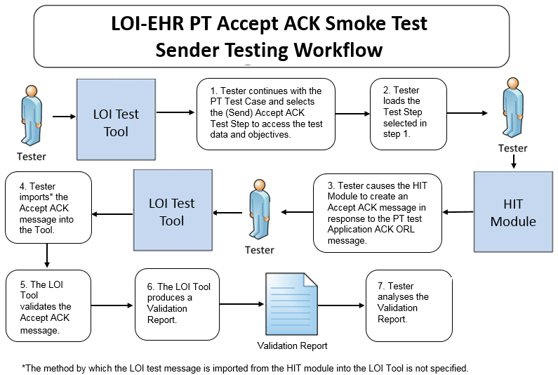
Send Accept ACK Testing Workflow Diagram
This diagram shows
How the test steps are sequenced for the send Accept Acknowledgement* message (sent in response to the Application Acknowledgement message)
When the Test Tool is to be used
*Acknowledgement messages are tested only in the PT Test Scenario

Slide 14
Test Cases and Test Steps
Test data are available in the LOI Test Tool via the Test Cases provided in the LOI-EHR Test Plan
The Test Cases are composed of Test Steps
Each Test Step includes a Test Story, Test Data Specification, Message Content Data Sheet, Test Message, and (where applicable) a Juror Document
The HL7 Version 2.5.1 Implementation Guide: S&I Framework Laboratory Orders (LOI) from EHR interoperability standard defines four Profile options relevant for conformance testing:
LOI_GU_PRU_PROFILE – ID: 2.16.840.1.113883.9.85
LOI_GU_PRN_PROFILE – ID: 2.16.840.1.113883.9.86
LOI_NG_PRU_PROFILE – ID: 2.16.840.1.113883.9.87
LOI_NG_PRN_PROFILE – ID: 2.16.840.1.113883.9.88
The Tool provides ten Test Cases for the GU Profile options and ten for the NG Profile options, some of which use either the PRU or PRN Profile option
For the purpose of the testing, conformance to either the GU_PRU, GU_PRN, NG_PRU, or NG_PRN Profile option is required — the Vendor will inform the Tester as to which Profile option their HIT Module is conformant

Slide 15
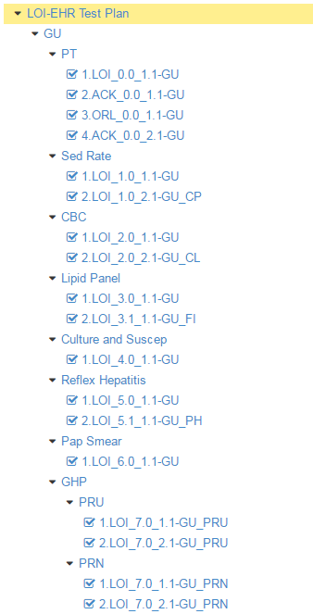
Test Cases and Test Steps (cont’d)
Test Cases/Steps for the four Profile options are provided in the LOI-EHR Test Plan in the LOI Test Tool
This figure shows a sub-set of the Test Cases/Steps in the LOI-EHR Test Plan for the GU Profile option
The Tester shall execute all ten Test Cases for either the GU or NG Profile (and in some instances for the GU_PRU or GU_PRN or NG_PRU or NG_PRN Profile option)
For certain Test Cases, the Tester need not execute optional* Test Cases
Profile option
Test Case
Test Step
Test Case
Test Step
GU_PRU Profile option
GU_PRN Profile option
*Support for the capabilities in optional Test Cases is preferred but not required

Slide 16
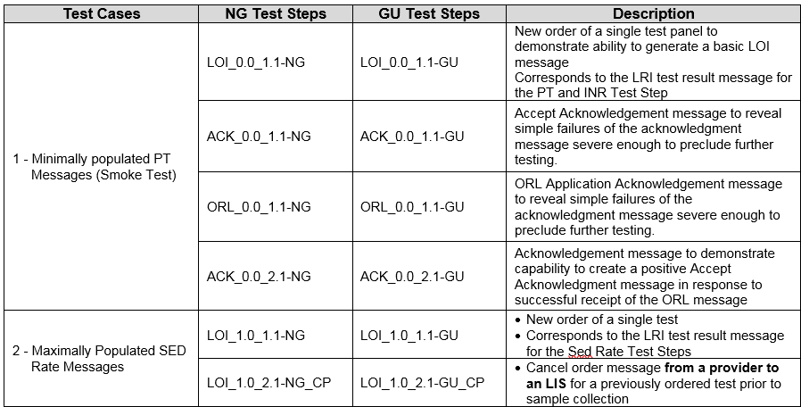
Test Cases and Test Steps (cont’d)
Test Steps for Test Cases 1-2 are shown in the table below
Minimally populated means the LOI example messages contain single occurrences of all required ("R") elements
Maximally populated means the LOI example messages contain all the R, RE, C(a/b) elements defined in the implementation guide

Slide 17
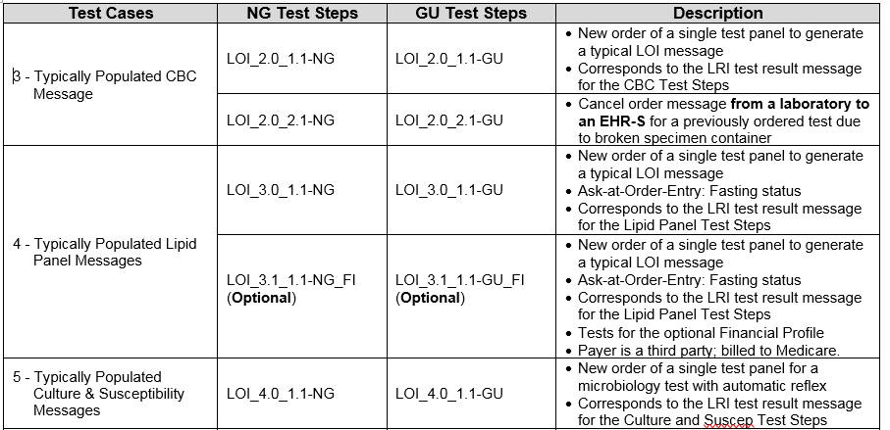
Test Cases and Test Steps (cont’d)
Test Steps for Test Cases 3-5 are shown in the table below
Typically populated means the LOI example message contains data that are routinely sent whether the data element is R (Required) or RE (Required, but may be empty)

Slide 18
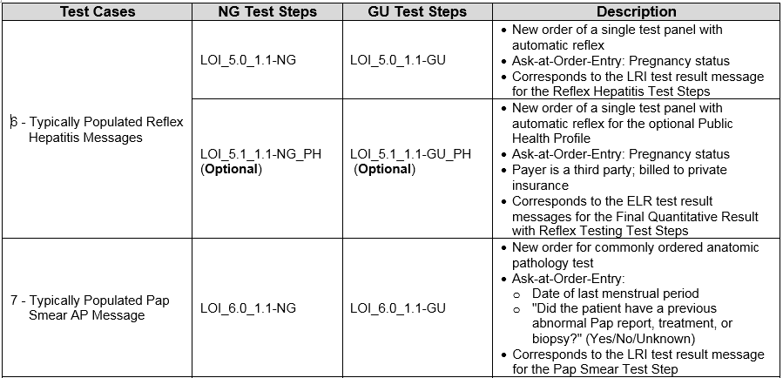
Test Cases and Test Steps (cont’d)
Test Steps for Test Cases 6-7 are shown in the table below
Typically populated means the LOI example message contains data that are routinely sent whether the data element is R (Required) or RE (Required, but may be empty)

Slide 19
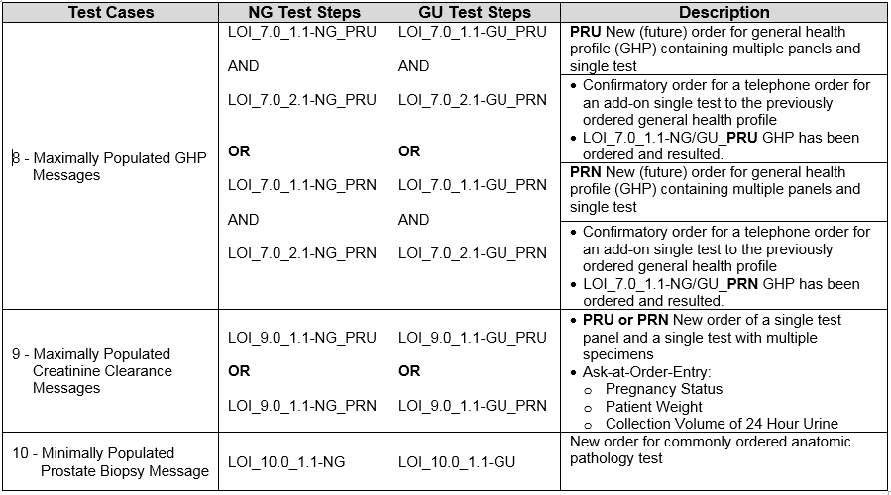
Test Cases and Test Steps (cont’d)
Test Steps for Test Cases 8-10 are shown in the table below
Minimally populated means the LOI example messages contain single occurrences of all required ("R") elements
Maximally populated means the LOI example messages contain all the R, RE, C(a/b) elements defined in the implementation guide

Slide 20
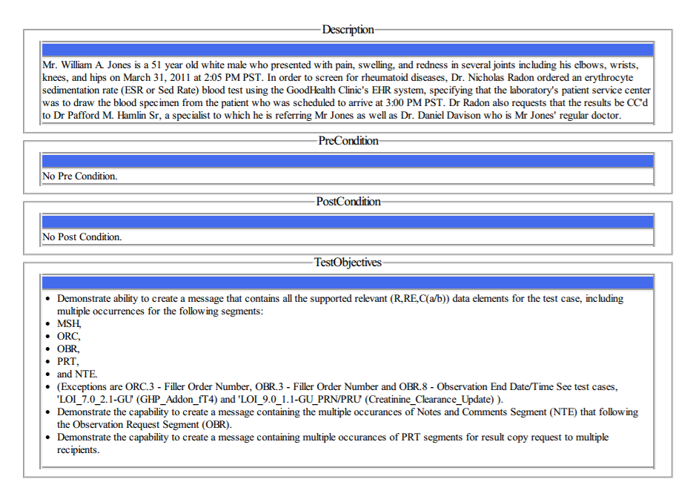
Test Data Documents* for Each Test Step
Test Story
Each Test Step includes a narrative Test Story that describes a real world situation and provides context for the Test Step
Along with the Test Story description is information about PreConditions, PostConditions, Test Objectives, and (where applicable) Notes to Testers
Example: Test Data pdf document for the LOI_1.0_1.1-GU_ Sed Rate Order Test Step
*Available for viewing online and via downloaded pdf or txt file

Slide 21
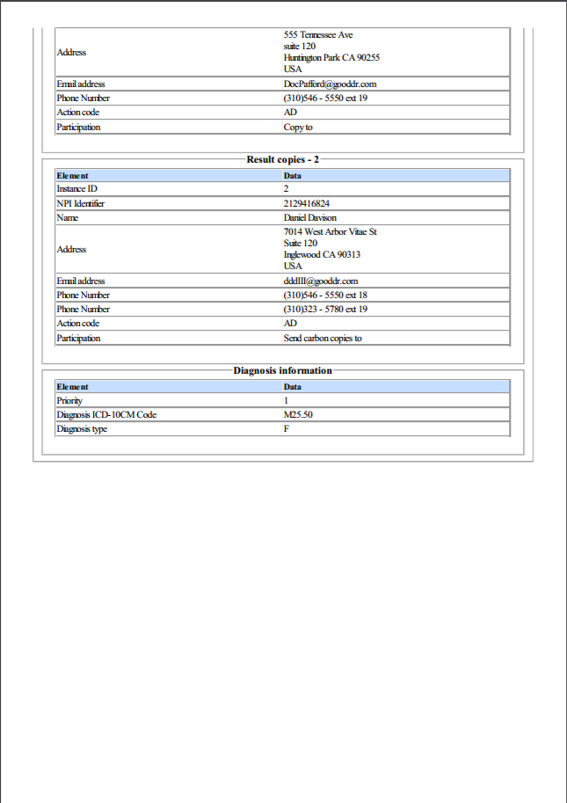
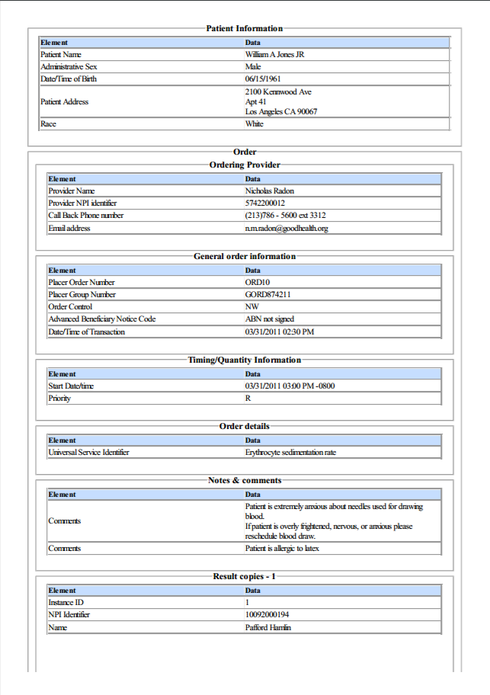
Test Data Documents for Each Test Step (cont’d)
Test Data Specification
Each Test Step includes a Test Data Specification that
Lists data associated with the Test Story
Consists of typical information found in the clinical setting
A test message is generated using these data and the LOI-EHR Test Tool functions
Example: Test Data pdf document for the LOI_1.0_1.1-GU_ Sed Rate Order Test Step
21
Notes:
21

Slide 22
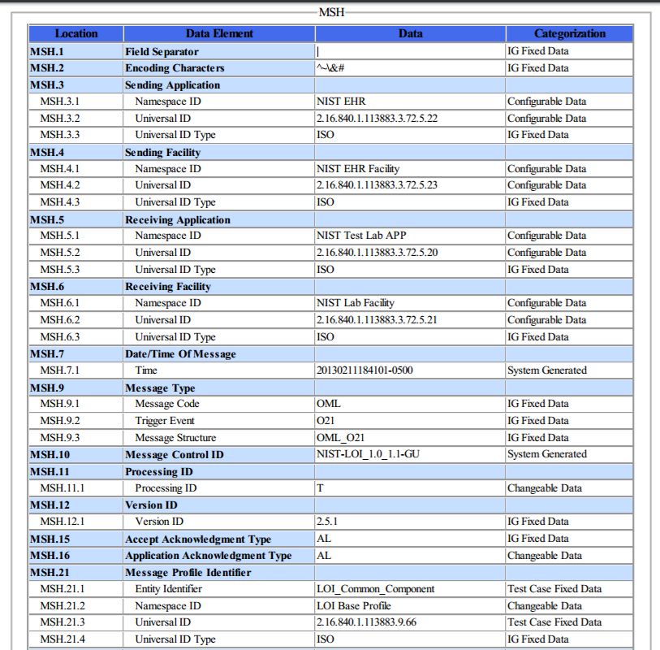
Test Data Documents for Each Test Step (cont’d)
Message Content Data Sheet
Each Test Step includes a Message Content Data Sheet that shows a conformant message instance
The category of the test data is listed in the Categorization column
The Categorization indicates how the data in the messages that are imported into the Tool are assessed by the validation engine
Example: Test Data pdf document for the LOI_1.0_1.1-GU_ Sed Rate Order Test Step
22
Notes:
22

Slide 23
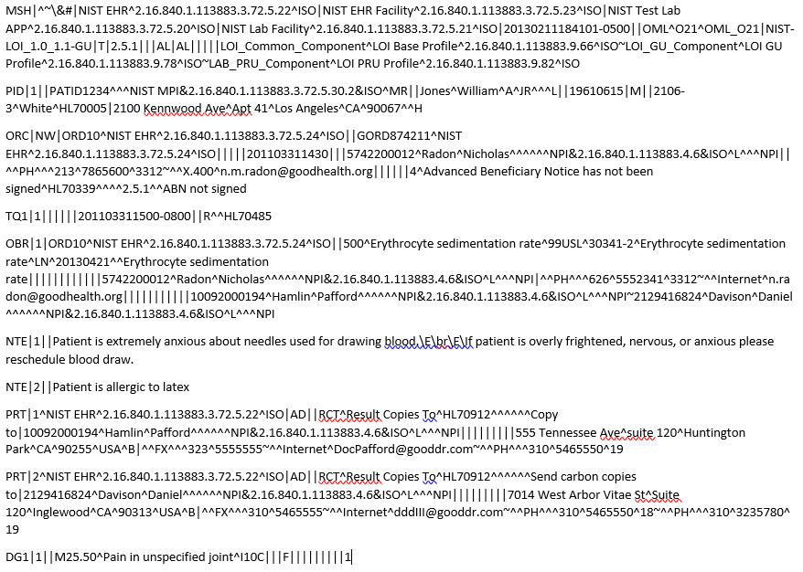
Test Data Documents for Each Test Step (cont’d)
Example Test Message
A test message is provided that coincides with the Test Story for the Test Step
For the LOI-EHR Test Plan, the lab order test messages are created and exported (sent) by the HIT Module being tested and are imported (received) by the LOI Test Tool (acting as the LIS or EHR-S lab module)
Example: Test Message for the
LOI_1.0_1.1-GU_ Sed Rate Order Test Step

Slide 24
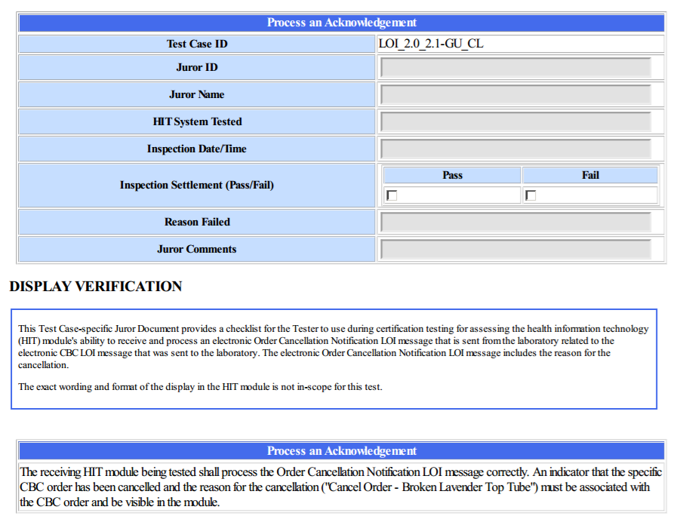
Test Data Documents for Each Test Step (cont’d)
Juror Document
Each (receiver) Test Step includes a Juror Document – a checklist used by the Tester/Inspector to assess and record whether the HIT Module being tested is able to process the message according to the LOI specification
Example: Juror Document pdf for the
LRI_2.0_2.1-GU_CL Cancel CBC Lab Order Test Step
24
Notes:
24

Slide 25
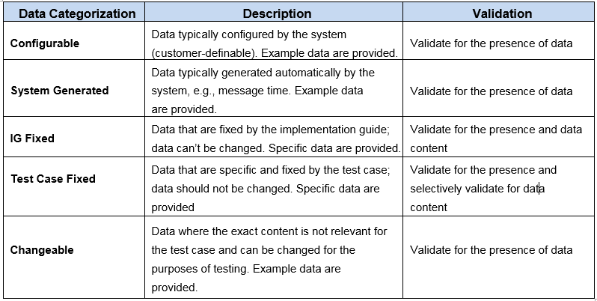
Test Data Categorization and Validation
The Message Content Data Sheet shows the categorization of the test data that are provided for each Location in the LRI message
The category assigned to the data is directly related to how the associated message content is validated by the Test Tool, as shown in the table below

Slide 26
Test Data Validation
The Test Tool validates a message for the presence and exact content of the data for Locations assigned to the IG Fixed category and for selective Locations assigned to the Test Case Fixed category
The Test Tool validates a message for the presence of data for Locations assigned to any of the other categories
These data are necessary for the transaction, but the exact content is either not relevant for the Test Step or may be system-dependent
Example: Universal ID for the Performing Organization
The Tester may also inspect the message during validation; the Inspection Test Guides in the Normative Test Process Document provide guidance
Location | Value | Category | Assessment
OBR.4.1 | 500 | Test Case Fixed Data | Content must be present and exactly “500”
OBR.4.2 | Erythrocyte sedimentation rate* | Changeable Data | Content must be present and indicate a value equivalent to Erythrocyte sedimentation rate
OBR.4.3 | 99USL | Test Case Fixed Data | Content must be present and exactly “99USL”
OBR.2.3 | 2.16.840.1.113883.3.72.5.24 | Configurable Data | Content must be present and a valid value
OBR.2.4 | ISO | IG Fixed Data | Content must be present and exactly “ISO”
*This text is provided as the Value for Location OBR.4.2 in the message for the LOI_1.0_1.1-GU Test Step

Slide 27
NIST LOI-EHR Test Tool Overview
Purpose: The tool validates LOI messages created by HIT Modules and is intended to be used for conformance testing according to the standards listed on the Conformance Standards page of this slide set
Tool Key Capabilities
Context-based testing / LOI-EHR Test Plan | Used for conformance testing driven by test data Validates HIT Modules that create HL7 messages in accordance with the ONC S&I Framework Laboratory Orders (LOI) to EHR implementation guide (IG) Provides Juror document for inspection testing
Profile Viewer | Provides a browse-able version of the conformance profile that encapsulates the requirements. Profile Viewer tab is accessible in Context-based testing once a Test Case or Test Step is “loaded”. Can be used to assist in the interpretation of message errors.
Value Sets Browser | Provides a browse-able view of the Value Sets and Vocabulary requirements. Value Sets tab is accessible in Context-based testing once a Test Case or Test Step is “loaded”. Can be used to assist in the interpretation of value set errors.
Documentation | Provides access to documents that assist in using the Tool for conformance testing (including the NIST Normative Test Process Document, Implementation Guide, and Release Notes).
No registration or log-in credentials are required. Simply click on the link below (or type in the url) to access and use the Tool
NOTE: The Test Tool (.war file) can also be downloaded and installed locally.
NOTE: Web Application is compatible with Firefox, Chrome, Safari, and IE9+. Recommended browsers are Firefox and Chrome.
Register to Google Group at: https://groups.google.com/d/forum/hl7v2-lab-orders-interface-testing to ask questions and provide feedback.
hl7v2-loi-r1-testing.nist.gov

Slide 28
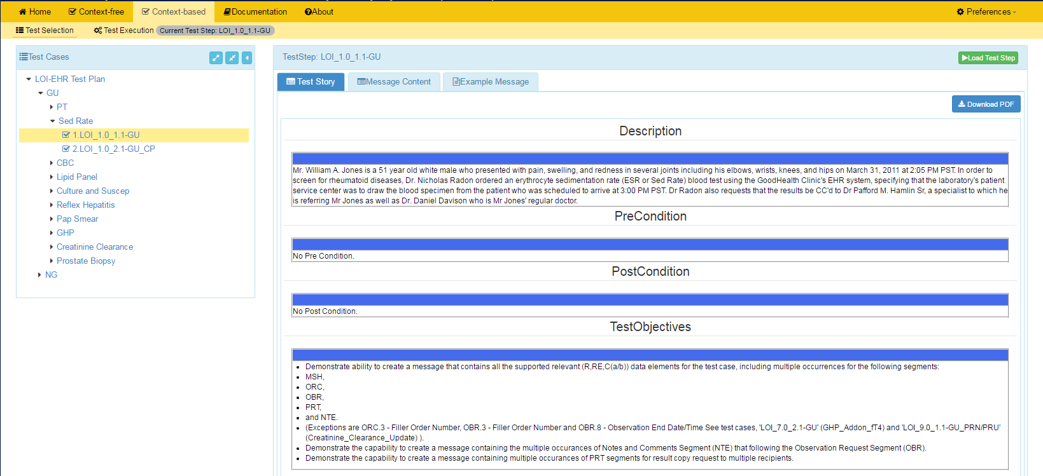
NIST LOI-EHR Test Tool Screen Shot
1
Open LOI Validation tool using link:
and click on Context-based
(hl7v2-loi-r1-testing.nist.gov)
2
Test Selection view of page displays.
3
Click on arrows to open LOI-EHR Test Plan and then the set of GU Test Cases.
4
Click on arrows to expand the Test Cases. Click on a Test Step.
5
Test Step Title and Test Story tab display.
6
Click Message Content tab to view and download the message content sheet
HIT Context-based Validation
This feature is used to test HIT Modules for conformance to the LOI standards. The majority of the validation involves automated testing that assesses the LOI messages created by the Module and sent to the LIS Test Harness. Another type of validation pertains to the inspection testing. This process utilizes an inspector to ascertain if the Acknowledgement and Cancel Order messages created by the LIS Test Harness are processed correctly by the Module. The Juror Document guides the inspector through the assessment process.
7
Click on Load Test Step button to proceed with conformance testing for the Test Step.

Slide 29
Resources
Test Tool Web Site (hl7v2-loi-r1-testing.nist.gov) provides
Test Tool (API, Web Application, and Desktop)
Test Cases/Steps, Test Stories, Test Data, Message Content Sheets, Example Messages, Juror Documents
User Documentation
Testing Artifacts
Message Profiles
Value Sets
Validation Reports
Contact
Rob Snelick (rsnelick@nist.gov)

